Slide 1
Quantitative Methods Lecture-7

Slide 2
Normal Distribution
(Ch 6 Business Statistics, Levine et al.)

Slide 3
So far and the next
Previous Session
Discreet Probability Distributions
Probability mass function
Today
Continuous and Normal Distributions

Slide 4
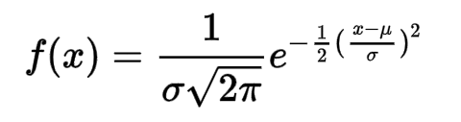
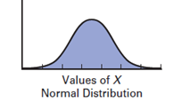

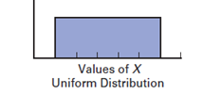
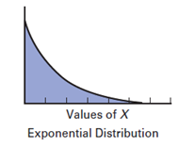

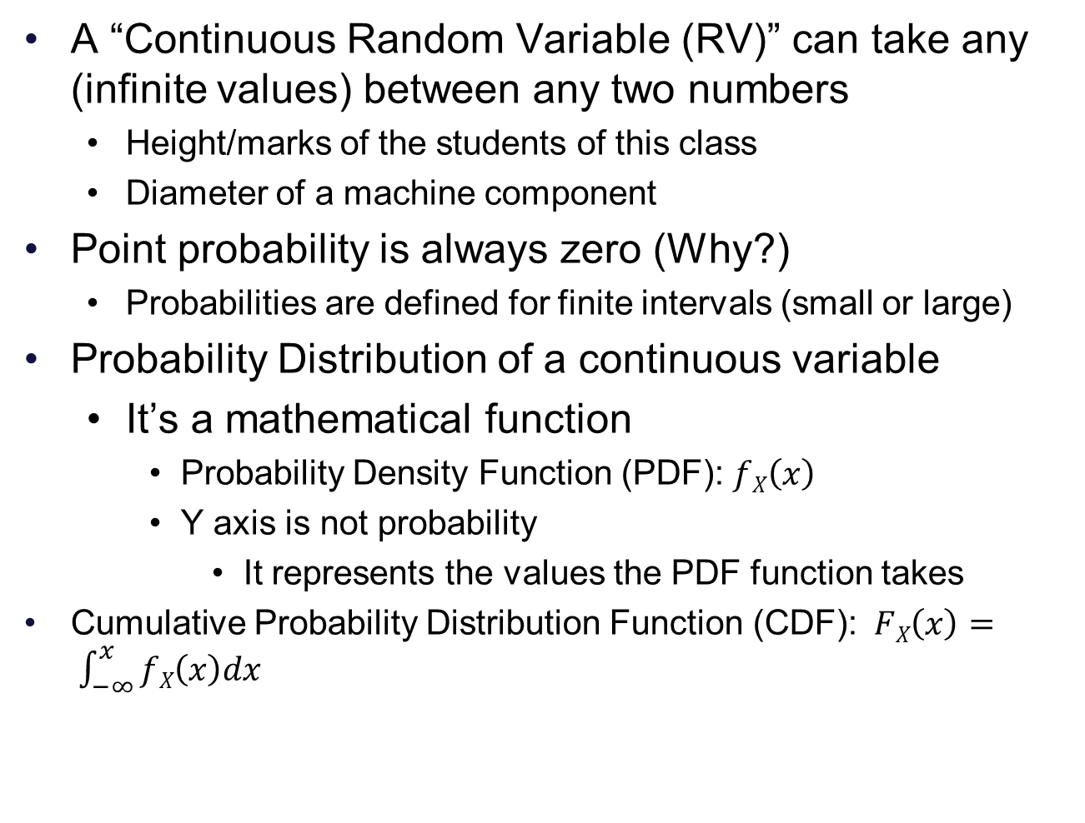
Continuous Random Variables
A “Continuous Random Variable (RV)” can take any (infinite values) between any two numbers
Height/marks of the students of this class
Diameter of a machine component
Point probability is always zero (Why?)
Probabilities are defined for finite intervals (small or large)
Probability Distribution of a continuous variable
It’s a mathematical function
Probability Density Function (PDF): $fX\left(x\right)$
Y axis is not probability
It represents the values the PDF function takes
Cumulative Probability Distribution Function (CDF): $FX\left(x\right)= \int_{−∞}^{x}{fX\left(x\right)dx}$

Slide 5
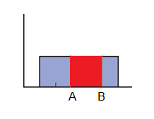

Calculating probabilities
Probability is defined as area under the PDF curve, between two points
$P \left(X≥A and X≤B\right)=\int_{A}^{B}{f\left(x\right)dx}$
Easier to calculate using CDF
$P \left(X≥A and X≤B\right)$ = $FX\left(B\right) −FX\left(A\right)$
Uniform PDF

Slide 6
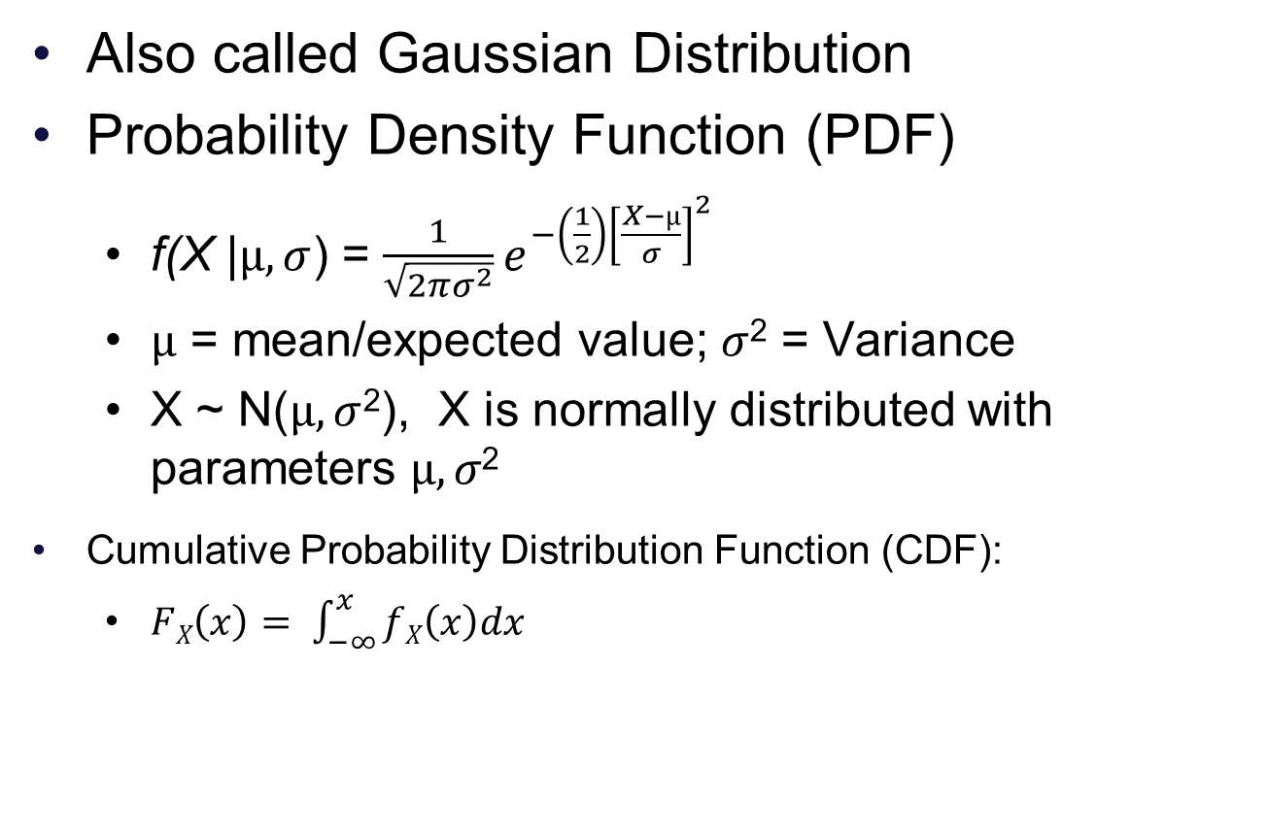
Normal Distribution
Also called Gaussian Distribution
Probability Density Function (PDF)
f(X |$µ,σ$) = $\frac{1}{\sqrt{2πσ^{2}}}e^{−\left(\frac{1}{2}\right){\left[\frac{X−µ}{σ}\right]}^{2}}$
$µ$ = mean/expected value; $σ$² = Variance
X ~ N($µ,σ$²), X is normally distributed with parameters $µ,σ\text{2}$
Cumulative Probability Distribution Function (CDF):
$FX\left(x\right)= \int_{−∞}^{x}{fX\left(x\right)dx}$

Slide 7
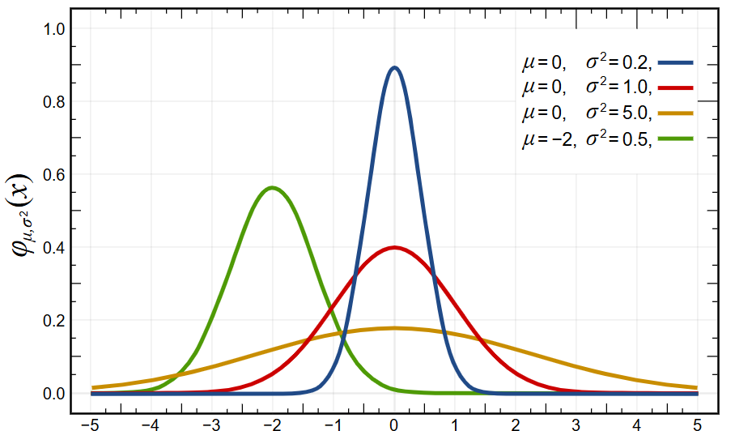
Normal Distribution
Two parameters define a normal distribution: µ and σ²
Higher σ increases the spread, change in µ shifts the curve
Image source: https://en.wikipedia.org/wiki/Normal_distribution

Slide 8
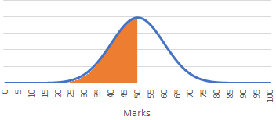
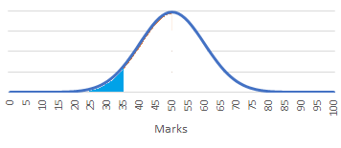
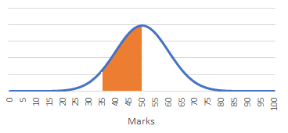


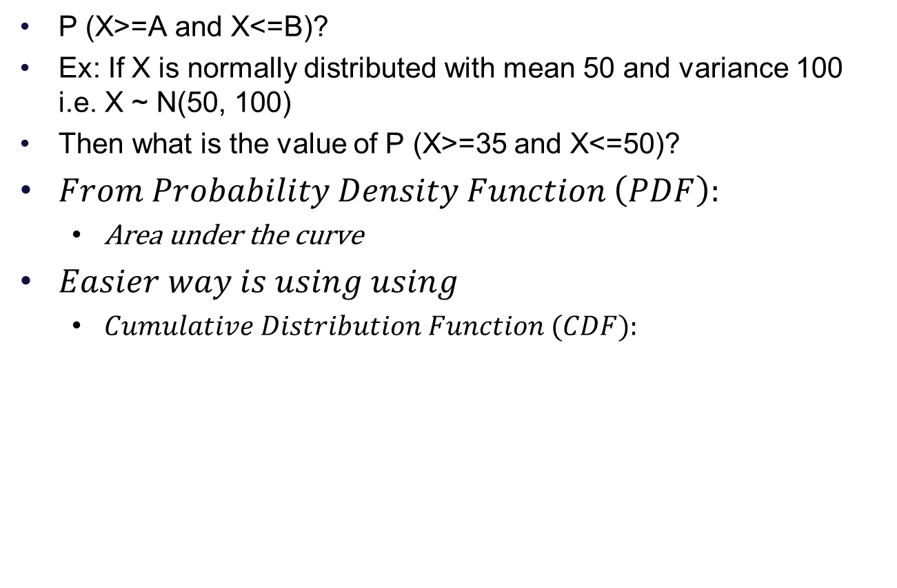
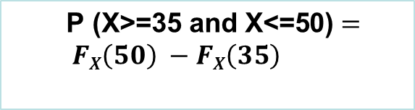

Calculating Normal Distribution Probabilities
P (X>=A and X<=B)?
Ex: If X is normally distributed with mean 50 and variance 100 i.e. X ~ N(50, 100)
Then what is the value of P (X>=35 and X<=50)?
$From Probability Density Function \left(PDF\right):$
Area under the curve
$Easier way is using using$
$Cumulative Distribution Function (CDF):$
P (X<=50)?
P (X<=35))
$$FX\left(50\right)$$
$\text{P}\text{ (}\text{X}\text{>=35 }\text{and} \text{X}\text{<=50)}= FX\left(50\right) −FX\left(35\right)$
$$FX\left(35\right)$$
$$\text{P}\text{ (}\text{X}\text{>=35 }\text{and} \text{X}\text{<=50)}$$

Slide 9
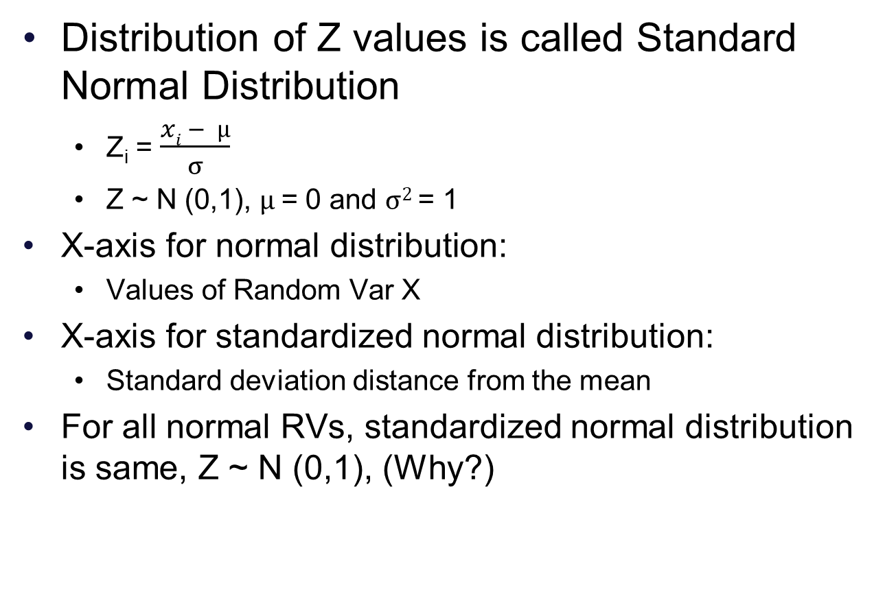
Standardized Normal Distribution
Distribution of Z values is called Standard Normal Distribution
Z_{i} = $\frac{xi − µ}{σ}$
Z ~ N (0,1), $µ$= 0 and $σ2$= 1
X-axis for normal distribution:
Values of Random Var X
X-axis for standardized normal distribution:
Standard deviation distance from the mean
For all normal RVs, standardized normal distribution is same, Z ~ N (0,1), (Why?)
Z

Slide 10
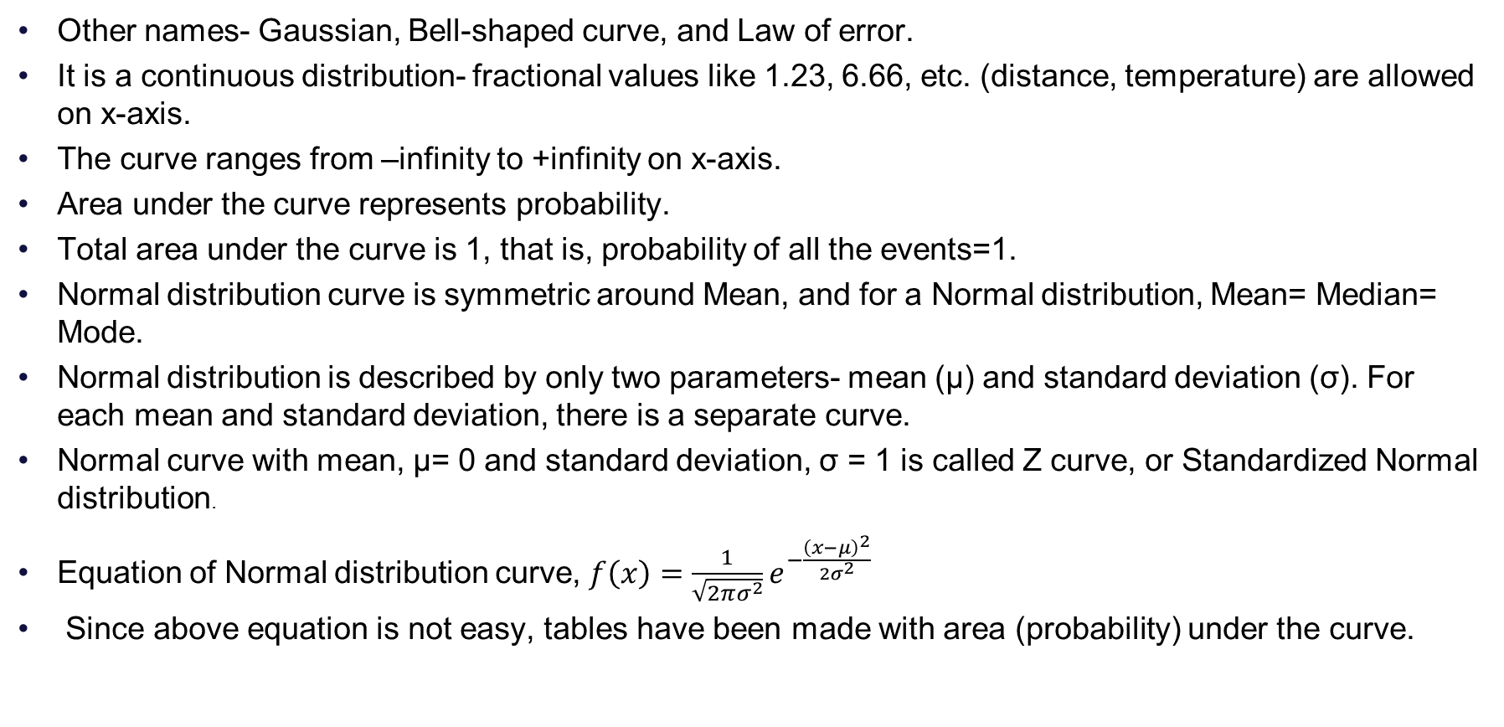
Normal Distribution
Other names- Gaussian, Bell-shaped curve, and Law of error.
It is a continuous distribution- fractional values like 1.23, 6.66, etc. (distance, temperature) are allowed on x-axis.
The curve ranges from –infinity to +infinity on x-axis.
Area under the curve represents probability.
Total area under the curve is 1, that is, probability of all the events=1.
Normal distribution curve is symmetric around Mean, and for a Normal distribution, Mean= Median= Mode.
Normal distribution is described by only two parameters- mean (μ) and standard deviation (σ). For each mean and standard deviation, there is a separate curve.
Normal curve with mean, μ= 0 and standard deviation, σ = 1 is called Z curve, or Standardized Normal distribution.
Equation of Normal distribution curve, $f\left(x\right)=\frac{1}{\sqrt{2πσ^{2}}}ⅇ^{−\frac{{\left(x−μ\right)}^{2}}{2σ^{2}}}$
Since above equation is not easy, tables have been made with area (probability) under the curve.

Slide 11
Calculating Normal probabilities
Example scenario
Assuming students marks are normally distributed with µ=50 and σ=10
X ~ N (50, 100)
What is the probability of a student receiving 45 or less marks?
Or proportion of the students receiving 45 or less marks [P(X<=45)]
Steps
Calculate Z values for cut off points
Find the cumulative probability up to the cut-off points from the z cumulative distribution table (standardized normal cumulative probability table)
Use these probability values to solve the questions
You can use this approach to solve any normal probability question

Slide 12
Calculating Normal probabilities
RV: X ~ N (µ = 50, σ =10); µ=50 and σ=10
P(X<=45.5)? = P(X<45.5)+ P(X=45.5) = P(X<45.5)
What % of the students have scored 45.5 or less?
Steps
Calculate Z value of the value of interest
(45.5-50)/10 = -0.45
Find the cumulative probability up to that value from the z table
0.3264 or 32.64%
PDF
Z
CDF

Slide 13
Calculating Normal probabilities
If X ~ N (μ=50, σ=10), then P(X>=45) and P(X<=55)?
What % of students have scores between 45 and 55
Steps
Calculate Z values of the values of interest
P(X<=45) and P(X<=55), Z for 45 and 55?
(45-50)/10 = -0.5 & (55-50)/10 = 0.5
Find the cumulative probabilities up to the values of interest from the Z table
(P(Z<=0.5)? P(Z<=-0.5)?
P(Z<=0.5) - P(Z<=-0.5) = 0.6915 – 0.3085 = 0.3830 or 38.30%
PDF
CDF
Z - CDF
Z - CDF

Slide 14
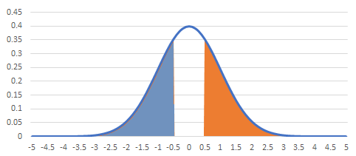
Calculating Normal probabilities
If X ~ N (μ=50, σ=10), What % of the students have scored more than 55 marks?
Steps
Calculate Z values of the value of interest, (Z for X=55?)
Z = (55-50)/10 = 0.5
Which of the shaded area is P(Z>=0.5)?
P(Z>=0.5) = 1- P(Z<=0.5), why?
P(Z>=0.5) = P(Z<=-0.5), why?
Using symmetry of the distribution
Cumulative prob values for Z=-0.5? and Z=0.5?
Is P(Z<=-.5) = 1- P(Z<=.5)?
1 – 0.6915 = 0.3085
Z - CDF
Z - CDF

Slide 15
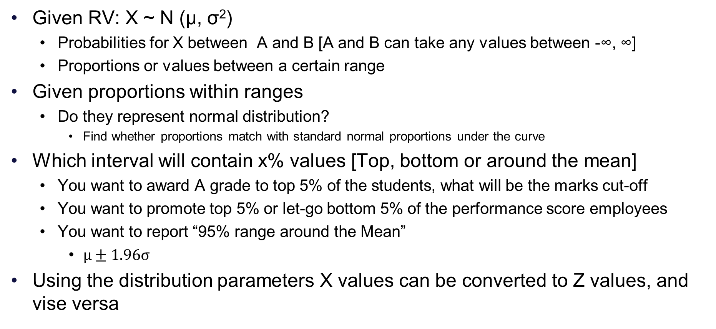
How questions may be asked
Given RV: X ~ N (µ, σ²)
Probabilities for X between A and B [A and B can take any values between -∞, ∞]
Proportions or values between a certain range
Given proportions within ranges
Do they represent normal distribution?
Find whether proportions match with standard normal proportions under the curve
Which interval will contain x% values [Top, bottom or around the mean]
You want to award A grade to top 5% of the students, what will be the marks cut-off
You want to promote top 5% or let-go bottom 5% of the performance score employees
You want to report “95% range around the Mean”
$µ±1.96σ$
Using the distribution parameters X values can be converted to Z values, and vise versa

Slide 16
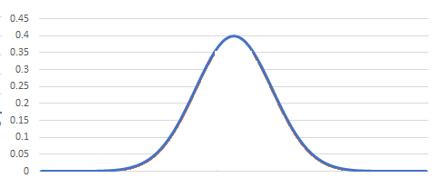
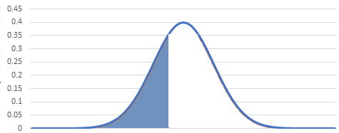
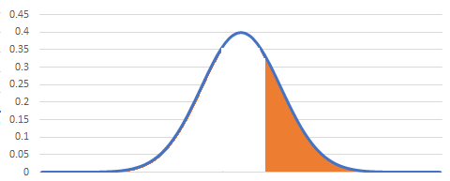
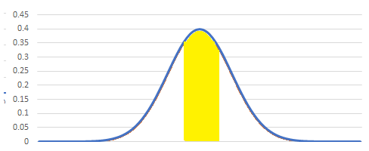
How questions may be asked
Steps to make life easy:
Always visualize the bell shaped PDF
Visualize the shaded areas of your interest
Find cut-off z-values of interest
Find cumulative probabilities for the z-values of interest (from the Z cumulative prob table)
That is area under the curve up-to those points from -∞
Work with these values to find the answer
X<=A
X between A and B
X>=A

Slide 17
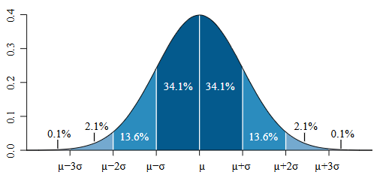
Some key normal distribution probabilities
For X ~N (μ, σ²)
Values within 1, 2 and 3 standard deviations
68%: About 68% of values are within one standard deviation of the mean [μ-σ <= X <= μ +σ ]
What are the Z values of interest here?
Z = -1 and Z = +1
95.5%: About 95.5% of values are within two standard deviations of the mean [μ -2σ <= X <= μ +2σ]
What are the Z values of interest here?
99.7%: About 99.7% of values are within three standard deviations of the mean [μ -3σ <= X <= μ +3σ]
Source: https://en.wikipedia.org/wiki/Normal_distribution
Practically, most of the distribution is contained withing 3 standard deviations of the mean

Slide 18
Some key normal distribution probabilities
90%, 95% and 99% intervals around the mean value
90% of values fall within 1.65 standard deviations of the mean [-1.65 <= Z <= 1.65 ]
95% of values fall within 1.96 standard deviations of the mean [-1.96 <= Z <= 1.96]
99% of values fall within 2.58 standard deviations of the mean [-2.58 <= Z <= 2.58]
Source: https://en.wikipedia.org/wiki/Normal_distribution
Important homework: Verify all the statements on this and previous slide using Z cumulative probability table

Slide 19
Q&A

